Slide 1

https://www.uni-goettingen.de/en/48115.html
Unless I explicitly state otherwise, images and cartoons are created using ChatGPT.
You may use this material free of charge under the terms of the CC BY license. This requires that you provide appropriate attribution to the author: W. Link, University of Goettingen, Germany.
In a few cases, individual images, photographs, or similar material may be subject to a more restrictive Creative Commons license. Where this applies, it is explicitly indicated, and you must comply with the stated license terms for those items.
Please check the license information carefully before reuse. Responsibility for complying with the applicable license terms rests entirely with you.
PopGen_Ch-1
Population Genetics; Hardy-Weinberg-Equilibrium I
1

Slide 2
Sequential Number: #2
UNPLAB-PopGen_Ch-1[HWE I]
I am Wolfgang Link. From 1995 on for several decades I taught Plant Breeding at Georg-August University Göttingen, Germany (ww.uni-goettingen.de/de/48115.html). UNPLAB means ‘Understand Plant Breeding’. If you find mistakes (you will, although I tried hard to avoid them), please tell me so. I you find this œuvre useful, tell others to use it as well. I personally am completely in favour of this material being free for use in whatever way, but everyone must know for themselves how to deal with copyright and the like. I have tried hard to quote everything correctly, but of course a 100% guarantee is literally impossible. I have no financial intentions or dependencies or anything like that, I was and am completely free in what I write. Anyone who is toying with the idea of harming me with or because of this work should put these thoughts away. I am not prepared for trouble in my advanced age
I have gladly and with commitment put the sum and essence of my teaching into this form; to make the field of Plant Breeding accessible to learners and experts – yet in my own way. I hope it helps; one or the other.
2

Slide 3
Keywords of this chapter:
Population. Genotype frequency. Gamete frequency. Allele frequency. Random mating. Hardy-Weinberg-Equilibrium (HWE).
No Selection no Mutation no Migration no Random Drift
Important Algebra of this chapter:
p² + 2pq + q²; P=p²; H=2pq; Q=q². This is the ‘Algebra’ of Hardy-Weinberg
This chapter is the entrance into Population Genetics.
3

Slide 4
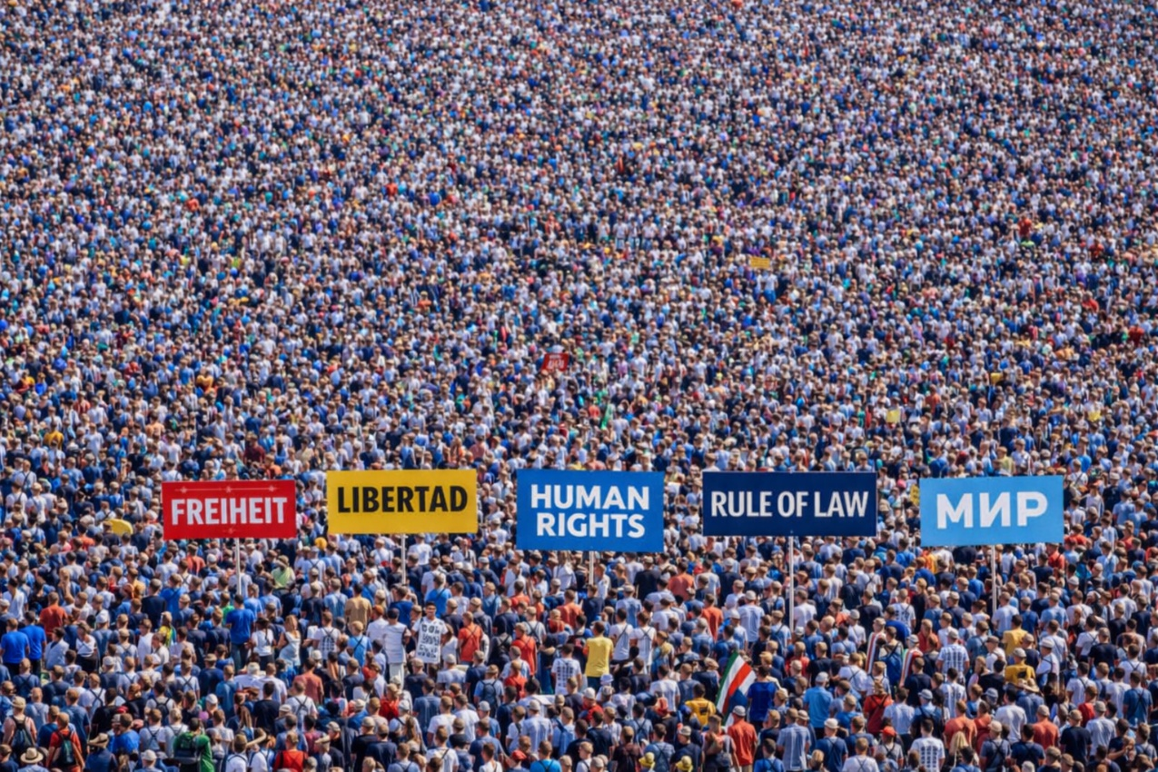

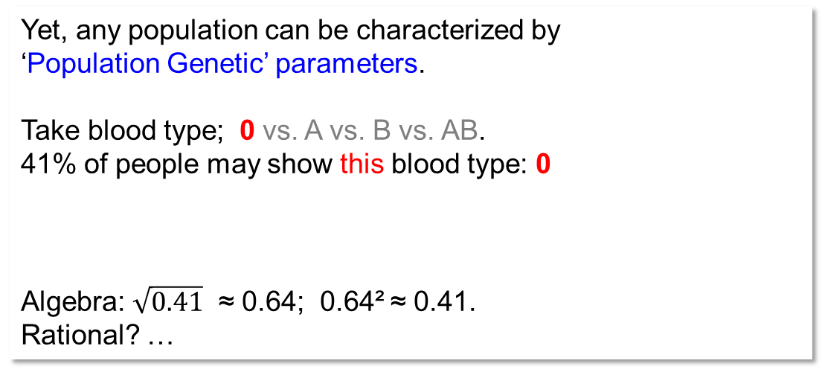
A population of humans; people. We usually consider plants; not people.
Yet, any population can be characterized by
‘Population Genetic’ parameters.
Take blood type; 0 vs. A vs. B vs. AB.
41% of people may show this blood type: 0 (e.g. Germany).
How frequent then are the gametes that carry this gene (the sperm cells, the egg cells of that population)?
f
Algebra: $\sqrt{0.41}$ ≈ 0.64; 0.64² ≈ 0.41.
Rational? …
A collection of people as a visualisation of a human population.
4

Slide 5

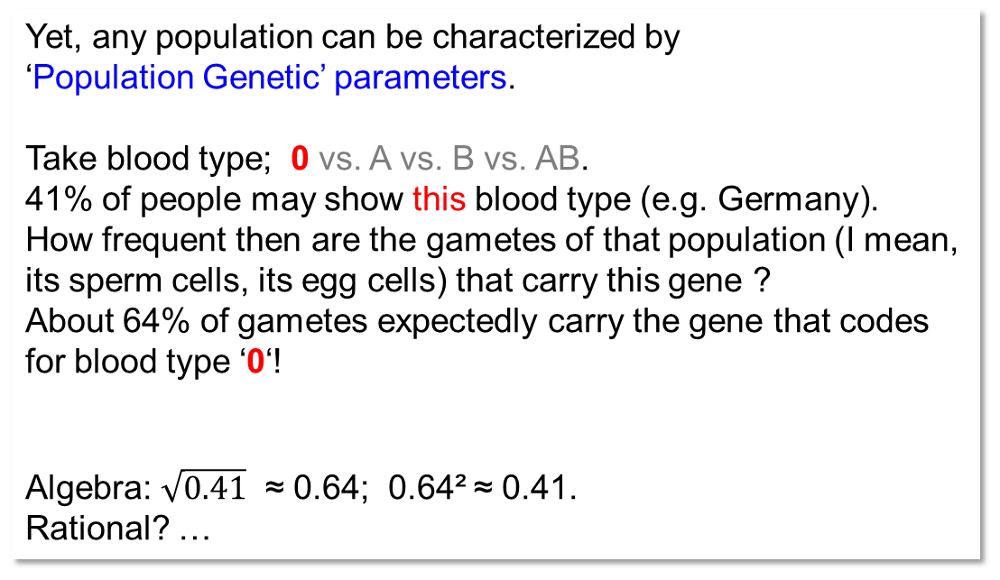
A population of humans; people. We usually considering plants, not people.
Yet, any population can be characterized by
‘Population Genetic’ parameters.
Take blood type; 0 vs. A vs. B vs. AB.
41% of people may show this blood type (e.g. Germany).
How frequent then are the gametes of that population (I mean, its sperm cells, its egg cells) that carry this gene ?
About 64% of gametes expectedly carry the gene that codes for blood type ‘0‘!
Algebra: $\sqrt{0.41}$ ≈ 0.64; 0.64² ≈ 0.41.
Rational? …
Rational …
This follows from the Hardy-Weinberg Law, which is a cornerstone, of utmost importance, for nearly all Population Genetics. It says that – given certain conditions – the genotypes (the individuals) which are homozygous blood-type-zero (in this case homozygous for ‘0’, we may write ‘00’) … their expected frequency is the square of the frequency of the gametes carrying that gene (better wording: ‘that allele’).
Their 41% frequency is the square of the 64% frequency of that allele. Better explanation … to come later here.
You see this: With haploid gametes, frequency of such gametes = frequency of that allele!
5

Slide 6
We need now some crucial, pertinent terms.
So that we can communicate about Population Genetics.
Population.
Genotype frequency. Gamete frequency. Allele frequency.
Random mating.
Selection, Migration, Drift.
Whatsoever ‘forces’ may create a deviation of a population (of its parameters) from ‘randomness’ and ‘undisturbedness’?
يلا
6

Slide 7

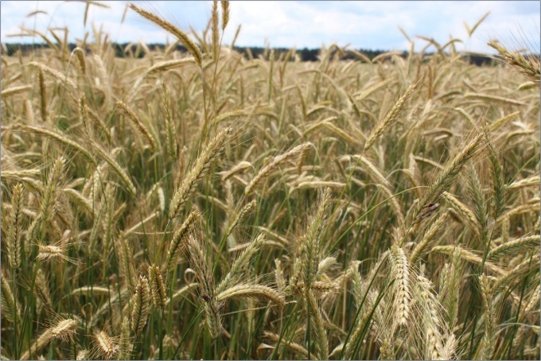
We need terms to communicate about Population Genetics.
A Population is a taxonomically ‘small’ unit (~sub-sub-species). A natural population may be separated from other populations e.g. because it lives on an island.
A Genotype such as AA or Aa or AA/Bb or A1A1/B1B2 etc. is a set of genes that ‘make’ the individual’s genotype. We say ‘genotype’ and focus on one gene, or on two genes, or on many, or even on ‘all’ genes. Several individuals may share the same genotype such as Aa; may even share he same entire genome. In plants, this is not rare (inbred lines; clones). In humans, this is true with identical twins.
Humans, animals: Usually „Individual makes a Genotype“
Plants in Plant Breeding: Typically „Many individuals make a Genotype“
Genotype Frequency
Gamete Frequency
Allele Frequency
These are Population Genetic parameter to characterize a population.
© AK Rada
If the species under consideration is diploid, hence if gametes are haploid, then Gamete Frequency and Allele Frequency tell the same; are the same.
For instance, p(A₁)=64% means: The allele A₁ occurs with 64% frequency, and therefore 64% of the gametes carry (identical copies of) this allele ‘A1’.
“A1” and “A₁” say the same: „Allele one at that locus”. “A1” was obviously typed in a rush, “A₁” more patiently.
7

Slide 8

We need terms to communicate about Population Genetics.
A rye (Secale cereale, 2n=14) population
A current generation of a Population is a group of individuals that jointly reproduce and ‘make’ the next generation of this population. Typically, cross-breeding is assumed; yet, any type of reproduction may apply (one assumes that at least a small extent of crossing between the individuals happens; even if vegetative propagation or self-fertilization prevails).
Typically, each Individual in a such diverse population is thought to be (to have) a unique (private) Genotype (meant as genome-wide ‘genotype’). Saying ‘genotype’ is then like saying ‘individual’.
● Genotype Frequency (now: one-locus genotype) is the frequency (% or on 0-1 scale) of genotypes. Example: Frequency of ‘maintainer’ genotype (‘rf-rf’; maintainer: see later).
© Anna Kristina Rada 2016
● Gamete frequency: Frequency of ‘gamete-types’ in a population. E.g. 64% of gametes carry the ‘rf’ allele.
With one gene just once in genome (not always true) and if gametes are haploid (not always true), Gamete Frequency (64% pollen with ‘rf’) is the same as ● Allele Frequency (64% ‘rf’). Yes, I already mentioned this :-)
● Random mating: Random joining of male and female gametes. ● No Selection: All genotypes have same basic probability to be parents. ● No Migration: Population is ‘closed’. ● No Drift: Number of parents is very large. So very large that (if parents are unselected) the sum of their gametes is fully representative of the former generation (very large means N≈∞).
8

Slide 9

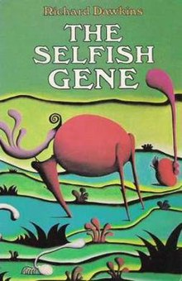
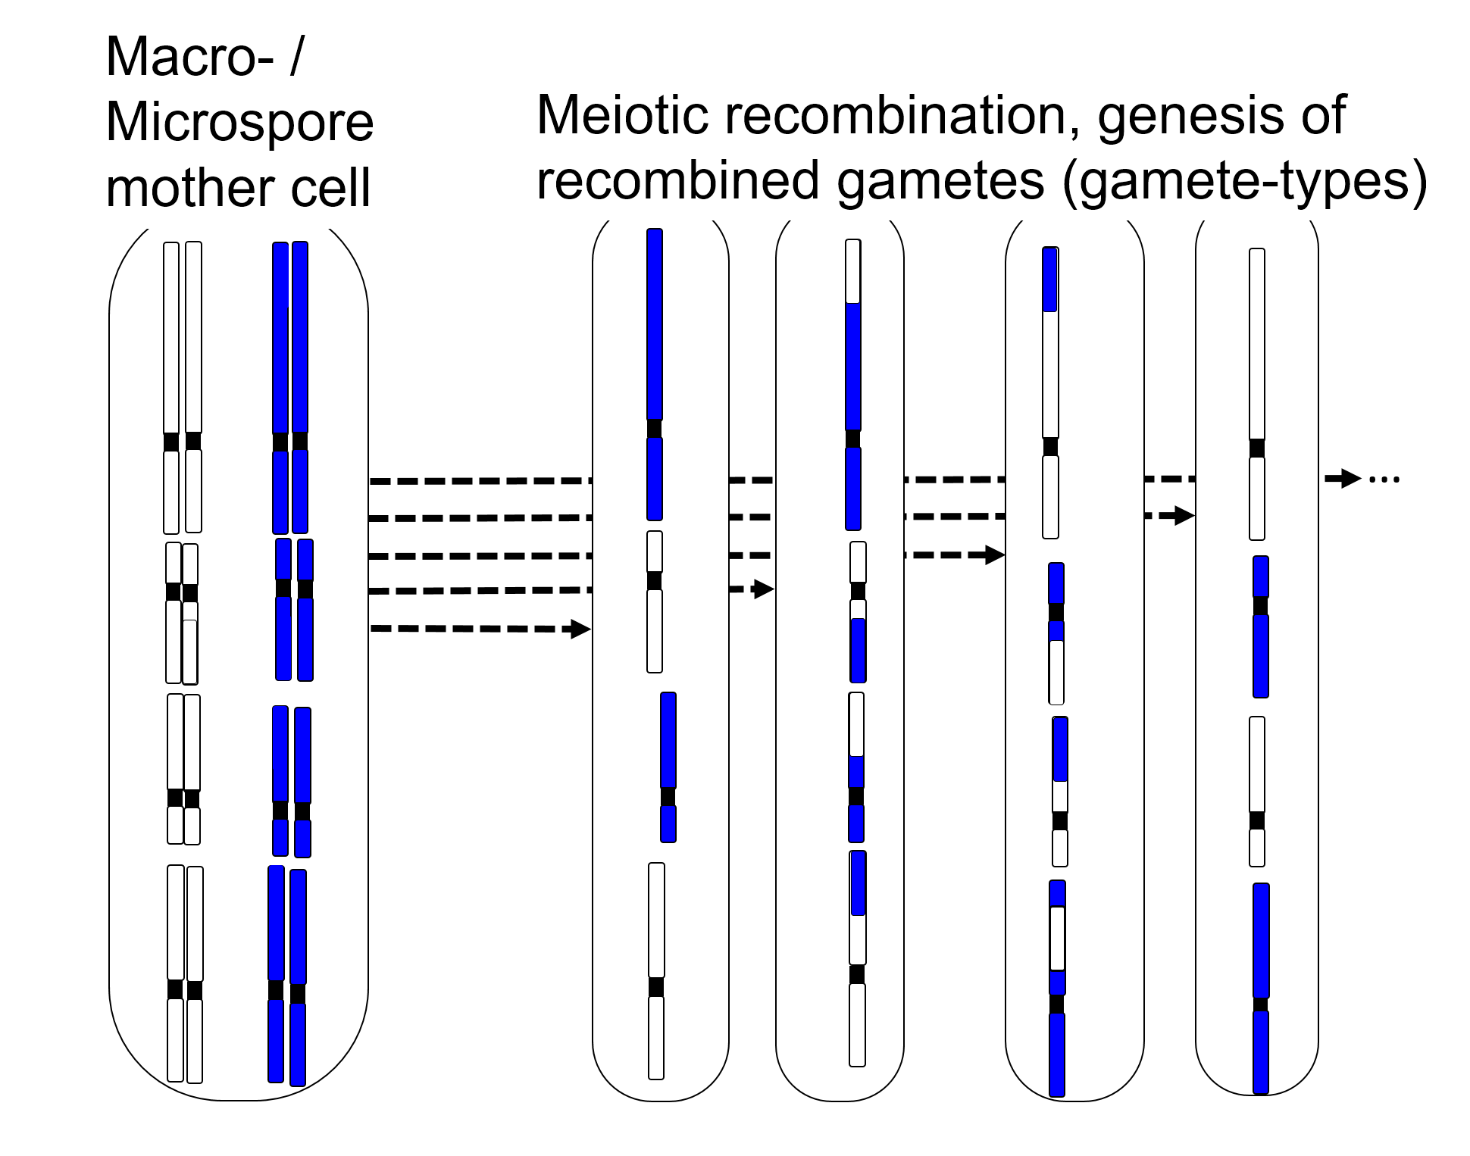
9
See Meiosis as ‘bomb’; and as creator.
Meiosis dis-integrates Genotypes and Haplotypes.
Meiosis destroys current-generation Genotypes and Haplotypes.
Meiotic recombination ►new Gametes and Genotypes.
As soon as there is at least some extent of cross-fertilization in a population, Meiosis tends to destroy the ‘old’ genotypes* and gamete-types*. They just vanish (‘they never come back’).
Haplotypes* and genotypes* are hence rather transient, ephemeral.
Genes are ‘eternal’; a population may be ‘eternal’, too.
Dawkins 1976; 2016. Oxford University Press. <The gene is ‚eternal‘ and the individual (genotype) is ‚ephemeral‘>
(flüchtig, vergänglich).
*genome-wide ‚types‘ are meant, not one-locus types.

Slide 10
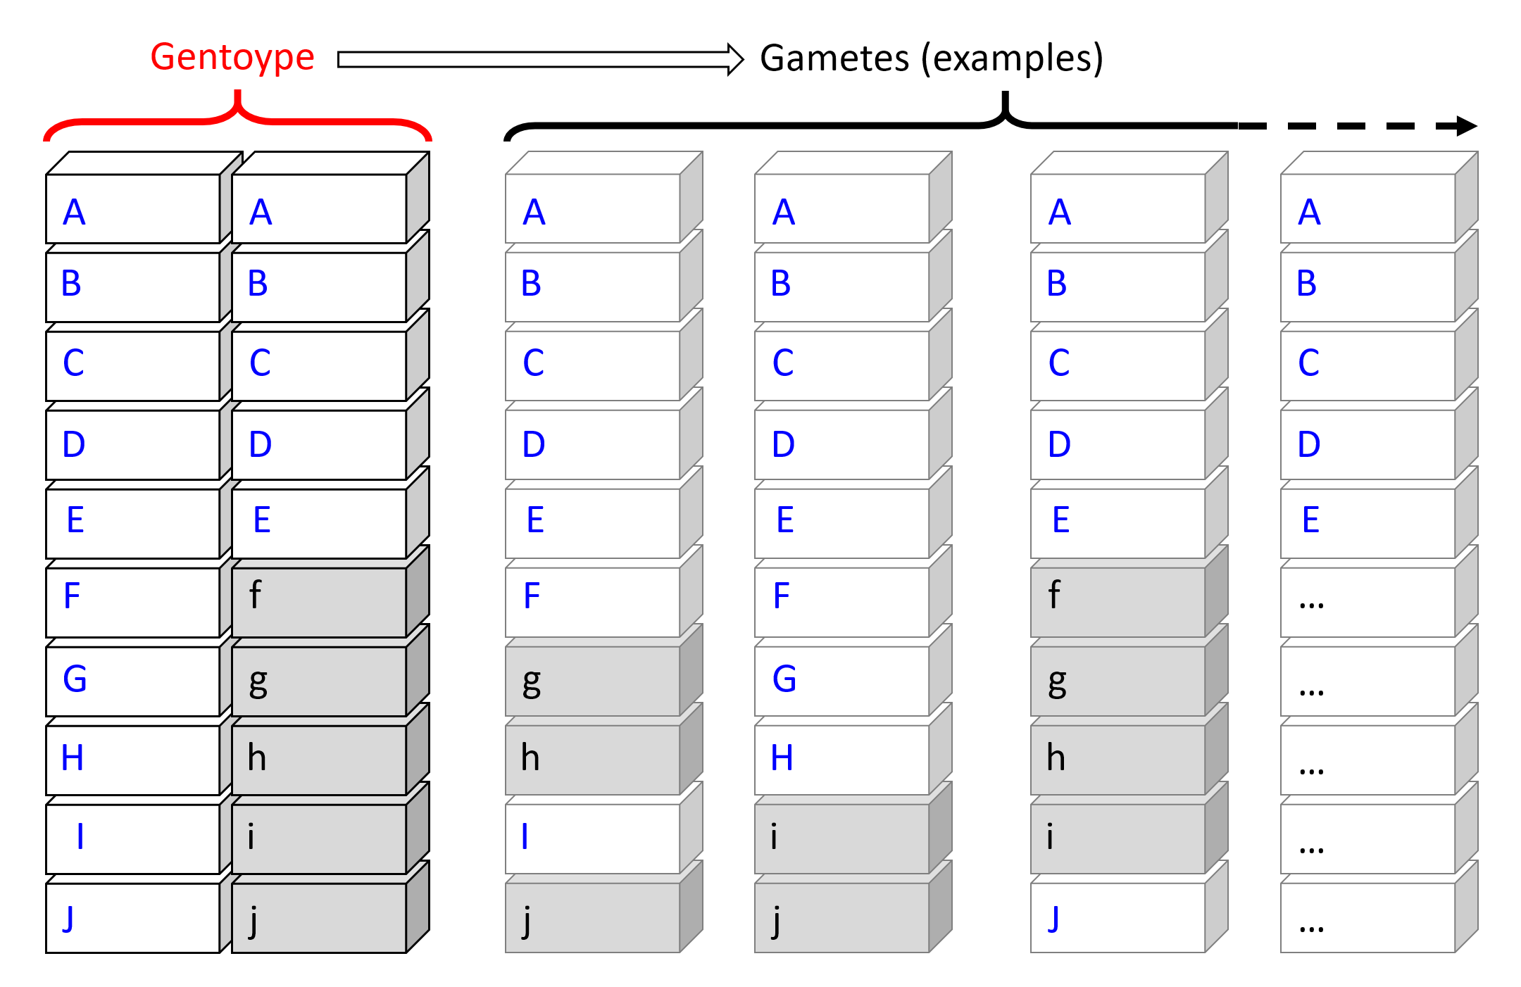
10
Why should Meiosis be seen as a ‘bomb’ ? … skip this page if you are in a hurry.
Take 10 loci (DOI: 10.1111/pbr.12918) for Ascochyta resistance (A to J, two alleles each). => 3¹⁰=59049 ‘ten-loci-genotypes’ are possible (3 since AA, Aa, aa). Take the frequencies of favourable allele as in that publication (12% to 86% per locus). Then (random mating) the probability of the ‘best’ homozygous genotype is very low, one in 16.8 millions.
Best gamete ≡ A/B/C/D/E/F/G/H/I/J. There are 2¹⁰ different gametes possible (2 since A, a), this best gamete-type (‘haplotype’) has a frequency of 1 in 4101.
This super-useful gamete may mate with a more ‘normal’ gamete to make a Genotype with, say, five loci heterozygous (see left). Let these five heterozygous loci ‘Ff’ to ‘Jj’ may segregate without linkage (be fully unlinked).
Best Haplotype
From this example Genotype: What is the probability that this best gamete-type (haplotype) re-occurs after meiosis (is not destroyed by meiosis)? Remember: Five heterozygous loci segregate. There are 2⁵ = 32 haplotypes (gamete-types) possible, and now, as we start with this Genotype, we have p=q=0.5 at these five loci, hence this best type of gamete A/B/C/D/E/F/G/H/I/J will re-occur only with a frequency of 0.5⁵=3.125%. You see the point: 0.5^{many} ≈ zero.
Message:: Meiosis dis-integrates genotypes and haplotypes. Meiosis makes recombination. It leads to new, novel sets of genes, to new gametes and genotypes in the next generation. Current-generation haplotypes and genotypes are transient, ephemeral. Genes are ‘eternal’*; a population may be ‘eternal’, too. *if we neglect Mutation.

Slide 11
Our next topic, a topic of utmost importance in Population Genetics and hence in Plant (and Animal) Breeding, is the so-called Hardy-Weinberg-Equilibrium.
Two scientists found this principle, independently from each other, in England and in Germany.
Geoffry Harold Hardy, British Mathematician (1877-1947)
Wilhelm Weinberg, German Medical Doctor and Geneticist (1862 -1937)
11

Slide 12
12
For this purpose, we have to digest this Algebraic (Stochastic) sentence on ‘independent events’:
If two events, A and B, are independent, then the joint Probability
P(A and B) = P(A ∩ B) = P(A)P(B).
“The Probability of joint occurrence is P(A)  P(B)”
If, for instance, the probability of A to occur, p(A) = 5%. And ...
if, for instance, the probability of B to occur, P(B) = 1%.
Then ...
well, then the probability of A and B to co-occur, simultaneously, is 1%-out-of-5%. This is 0.01  0.05=0.0005. This is 5 in 10.000 or 1 in 2.000.
12

Slide 13


A detour.
One could specify the probability that you wake up and ... it rains.
Say ... 5% of the days.
One could specify the probability that you wake up and ... you overslept.
Say ... 1% of the days.
There is a probability P that you overslept and it rains. What is the probability, (say percentage of days) with co-occurrence of both?
In 1% of the (rare) days with morning-rain you may oversleep.
1% of 5%, this is P = 0.01  0.05 = 0.0005, this is one day in 2000.
If it rained in many or most days at which you overslept, then you would conclude: “Seemingly there is an association between the two events”.
Then the two events would seem to be not independent.
13

Slide 14

Rational of “p² + 2pq + q²” which is the Algebra of Hardy-Weinberg.
We refer to one specific population; sometimes named ‘reference population’.
 | p(A₁) ♂ | q(A₂) ♂
p(A₁) ♀ | A₁A₁ | A₁A₂
q(A₂) ♀ | A₂A₁ | A₂A₂
♂
The frequency of A₁A₁ genotypes is specified as P(A₁A₁) .... CAPITAL letter P
The frequency of A₂A₂ genotypes is specified as Q(A₂A₂) .... CAPITAL letter Q
The frequency of A₁A₂ genotypes is specified as H(A₁A₂) .... CAPITAL letter H
Allele frequencies (=gamete frequ.) are specified with lower-case letters, p or q.
We assume the allele frequencies in the female gametes to be just the same as in the male gametes (‘normally’ this is a reasonable assumption).
We assume that the effect of an allele on phenotype is not depending on whether it was inherited to offspring via mother or via father ( ... reasonable assumption; check what “imprinting” may mean).
♀
Now: Hang on! Just one further move - thereafter you will have full transparency on Hardy-Weinberg-Equilibrium!
Watch out, in the frame of Hardy-Weinberg, we use the capital letter P to denote the genotype frequency of A1A1, even if ‚somewhere else‘ it is used for something else. And, as we are at it, H is the frequency of A1A2 and Q tells the frequency of A2A2. You saw it.
14

Slide 15
15
Rational of HWE: “p² + 2pq + q²”
 | p(A₁) ♂ | q(A₂) ♂
p(A₁) ♀ | A₁A₁ | A₁A₂
q(A₂) ♀ | A₂A₁ | A₂A₂
♂
The frequency of A₁A₁ genotypes is specified as P(A₁A₁) .... CAPITAL letter P
The frequency of A₂A₂ genotypes is specified as Q(A₂A₂) .... CAPITAL letter Q
The frequency of A₁A₂ genotypes is specified as H(A₁A₂) .... dito.
Allele (or gamete) frequencies are specified with lower-case letters, p or q.
We assume the allele frequencies in the female gametes to be just the same as in the male gametes (‘normally’ this is a reasonable assumption).
We assume that the effect of an allele on phenotype is not depending on whether it was inherited to offspring via mother or via father ( ... reasonable assumption; check what “imprinting” may mean).
♀
*https://s.gwdg.de/jjntF8
If (... okay, ‘if’) the female and the male gametes mate at random ... then the probability of A₁-egg cells that mate with A₁-sperm cells (pollen grains) and ‘make’ (A₁A₁) offspring p(A₁)  p(A₁) = P(A₁A₁) = p². ►P=p²
I tend to think ‘probability’ and ‘frequency’ as synonymous*; this is Agriculture, not Mathematics ☺
Take p(A₁) = 0.64. Then the* 64% of the A₁ egg cells mate (either) with the* 64% of A₁ pollen grains or with the*(100-64=) 36% of A₂ pollen. P(A₁A₁) = 0.64  0.64 = 0.41 (honestly, 0.4096).
The frequency of ‘A₁A₂+A₂A₁’ is of course 2pq=H. And Q = q², anyway clear ☺. And P+H+Q=p²+2pq+q²=1=100%.
*(well: a random hence representative sample of them)

Slide 16

That was it … all else is derived from this, just bells and whistles … 🕭
16

Slide 17
From here you may go to UNBLAB-PopGen_Ch-2[HWE II]
17

